Slide 1

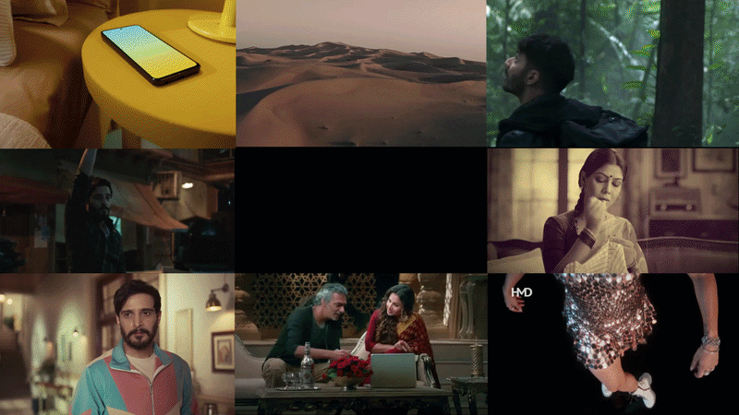

Notes:
Open warmly. And And Brand Partners — a full-funnel creative agency out of Delhi and Mumbai. This deck is our introduction: how we think and the work we make.

Slide 2


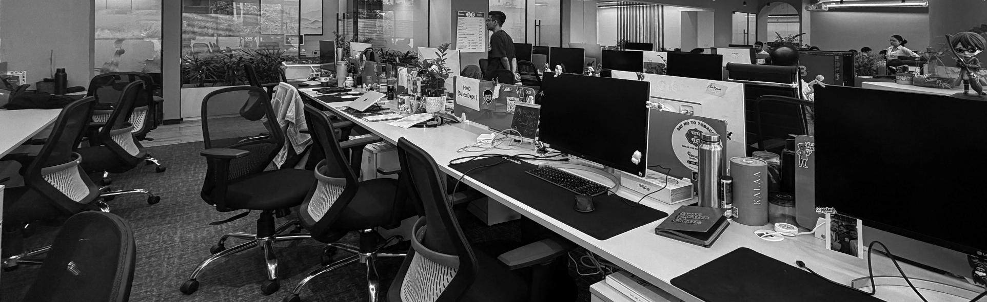
AGENCY CREDENTIALS · 2026
A Full-Funnel
Creative Agency
Notes:
Open warmly. And And Brand Partners — a full-funnel creative agency out of Delhi and Mumbai. This deck is our introduction: how we think and the work we make.

Slide 3

WHO WE ARE
Small enough to care.
Big enough to deliver.
We are a creative agency of 100+ people, turning insights into ideas and ideas into impact.
100+
2 offices
People
Delhi & Mumbai
Notes:
Our core idea: the craft and rigour of a legacy agency, run at the speed of a digital shop. 100+ people, two offices, one full-funnel team.

Slide 4






WHAT WE DO
Full-funnel, under one roof
Communication
Design
Digital
Brand strategy, campaigns & copy
Identity, packaging & content
Social, films & experiences
Tech
Performance
Consulting
Web, app & gaming builds
Media planning & ROAS-led growth
Category & brand advisory
Notes:
Full-funnel means we own every stage under one roof — no hand-offs. Six connected capabilities, and the ampersand is deliberate: we join things together.

Slide 5

HOW WE THINK
The Intelligence engine
Six lenses that turn data into a creative point of view.
Social
Search
Audience
Platform insights · User behaviour
· Formats & trends
SEO · Answer-engine
· Generative-engine optimisation
Consumer research · Trend analysis
Performance
Data
Tech
Media planning · Platform mix
· Content strategy
Analytics · Reporting · Insight derivation
Platform knowledge · Web, app & gaming
Notes:
Before we make anything, we interrogate the problem. Six intelligences feed every brief — this is the strategy engine that keeps our creative honest and effective.

Slide 6
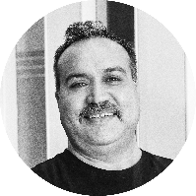
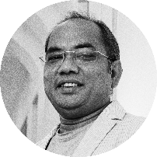

Deep experience. Fresh thinking.
Rohan Tandon
Harpal Singh
Rajesh Minocha
CEO · 25 YRS
CREATIVE LEAD · 30 YRS
CREATIVE LEAD · 23 YRS
Percept, Lowe & Indian Express. Sharp on marketing funnels, category and the craft of advertising.
Grey, TBWA & Lowe. Works across categories with deep craft in design, 3D, typography and tech.
McCann, Saatchi & Saatchi, Leo Burnett & Dentsu. Former ECD at Dentsu Happy McGarryBowen.
Notes:
The people you'll work with. Between the three of them, 78 years across Grey, TBWA, Lowe, McCann, Saatchi, Leo Burnett and Dentsu. Deep craft, hands-on.

Slide 7
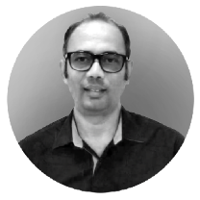
THE CORE TEAM
Mentor
AMJAD ALI
INVESTOR & MENTOR
Worked across a diverse range of categories such as automobiles, durables, mobiles, e-commerce, FMCG, fashion, travel etc. In an exciting journey of 3 decades, embraced evolving roles and responsibilities, contributing to the success of popular brands like Havells, Maruti, OLX, LG, Hero Motors, Greenply, Honda, Vistara, Dabur and many more. Most of these brands were Effie winners, proving their might in the marketplace. And with the meteoric rise of digital, transformed into a Performance Marketer building a full funnel expertise.
A leader by heart, transformed many mid-sized brands into category leaders.
Notes:
The people you'll work with. Between the three of them, 78 years across Grey, TBWA, Lowe, McCann, Saatchi, Leo Burnett and Dentsu. Deep craft, hands-on.

Slide 8

THE PROOF
Credentials
The awards we've won, and the brands who trust us to build them.
Notes:
Proof before pitch — the recognition we've earned and the brands who keep us on speed-dial.

Slide 9
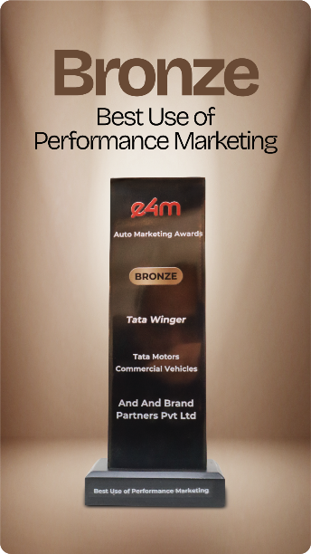
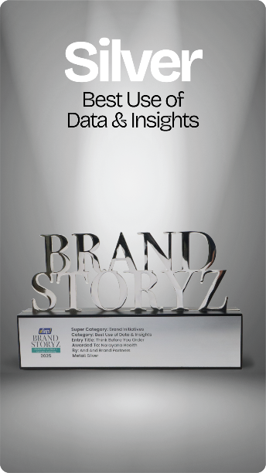
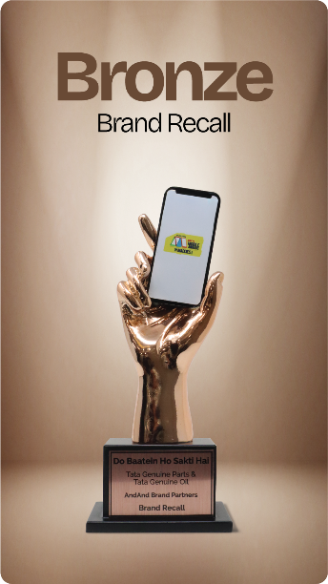
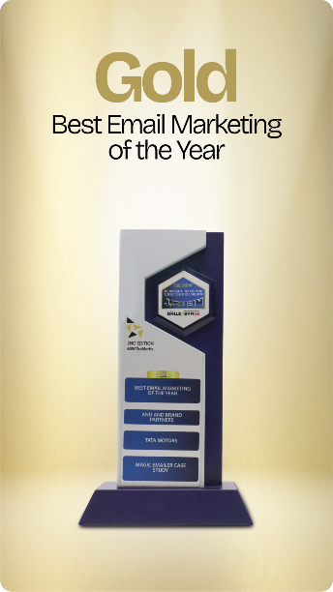
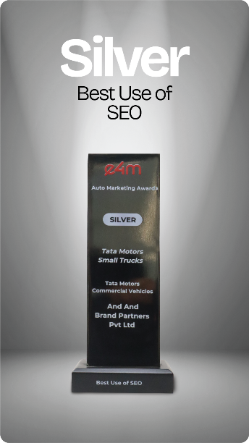

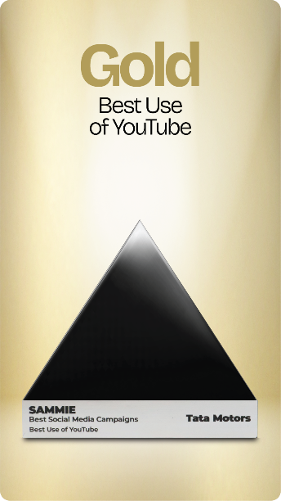
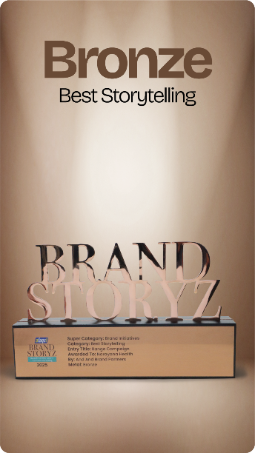

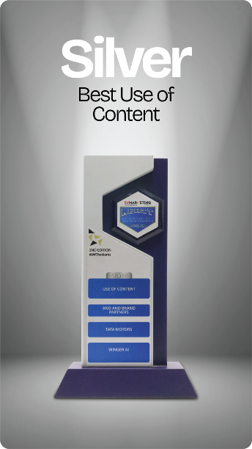
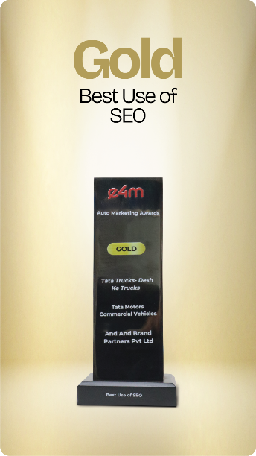
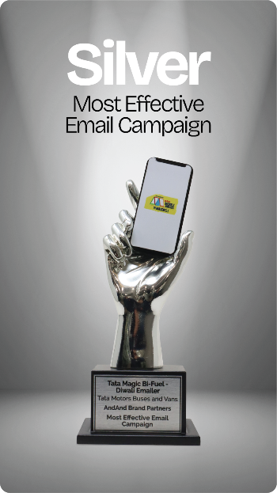
RECOGNITION
Awards & Recognition
Notes:
Gold and silver across YouTube, social and experiential — e4m, SAMMIE, Bharat Mobility and more. Recognition for work that also performed.

Slide 10
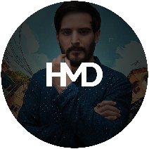


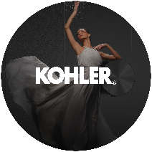
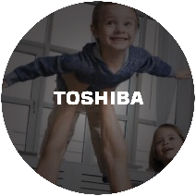



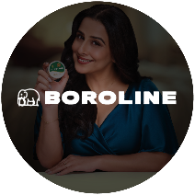




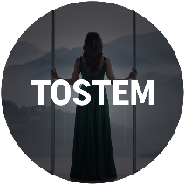

OUR CLIENTS
Brands we partner
Notes:
The company we keep — legacy leaders like Tata, Kohler, Havells and Toshiba, alongside new-age and D2C brands. We earn renewals, not just briefs.

Slide 11
THE WORK · 01 / 04
01
Films
Stories that carry a brand's whole world in thirty seconds or a full campaign.
Notes:
Section one — films. From a single hero cut to a full campaign, this is where craft is most visible.

Slide 12
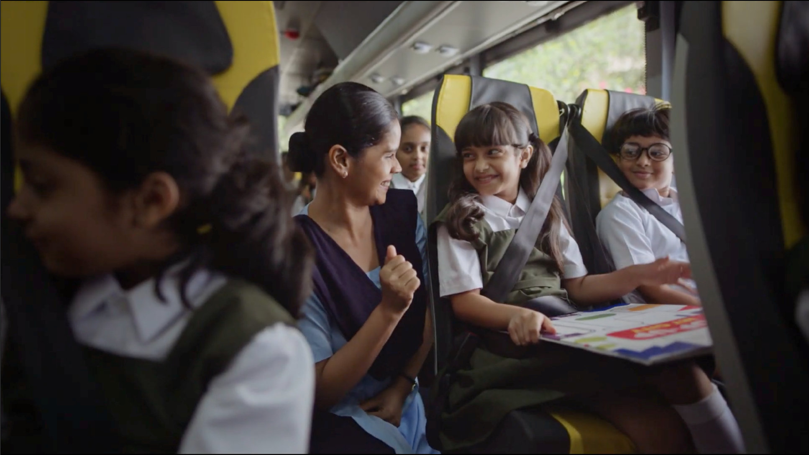
Tata Motors - Buses & Vans
Har Din Happy
▶
Watch on YouTube
Notes:
The Bold Look of Kohler — a cinematic brand film. Note the mood and finish. Click to watch the cut.

Slide 13
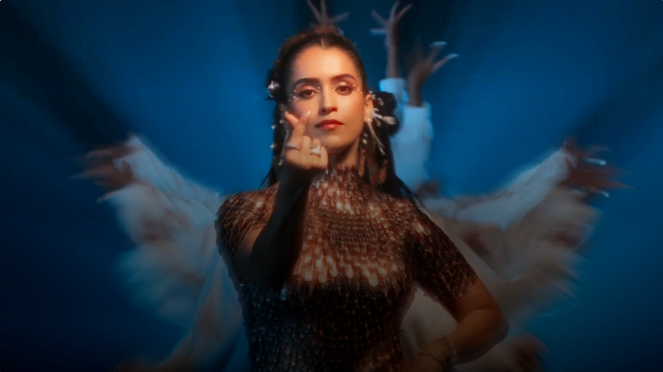
HMD - Crest Mobile
Hands-free selfie
▶
Watch on YouTube
Notes:
The Bold Look of Kohler — a cinematic brand film. Note the mood and finish. Click to watch the cut.

Slide 14
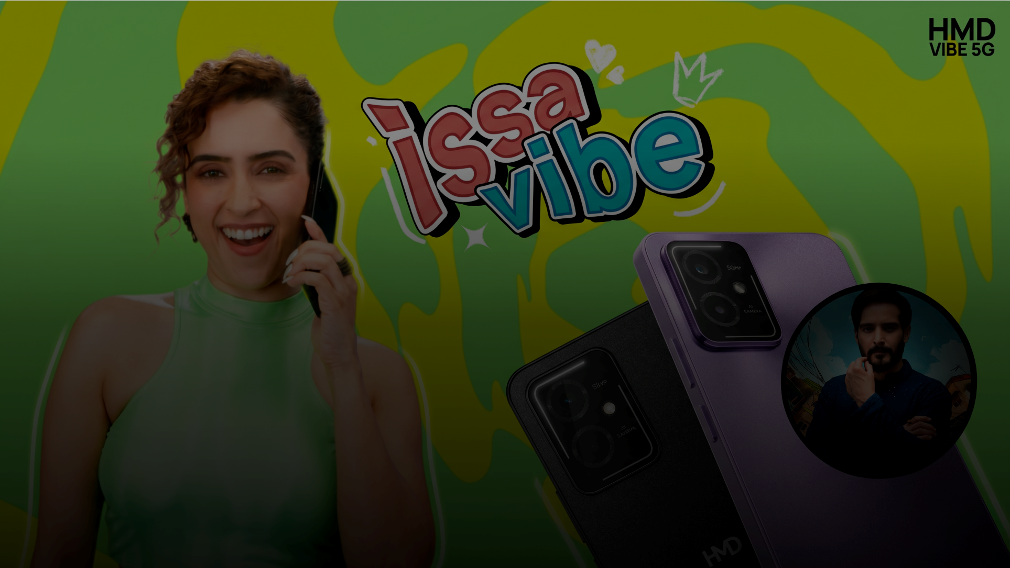
HMD - Vibe 5G
Issa Vibe
▶
Watch on YouTube
Notes:
The Bold Look of Kohler — a cinematic brand film. Note the mood and finish. Click to watch the cut.

Slide 15
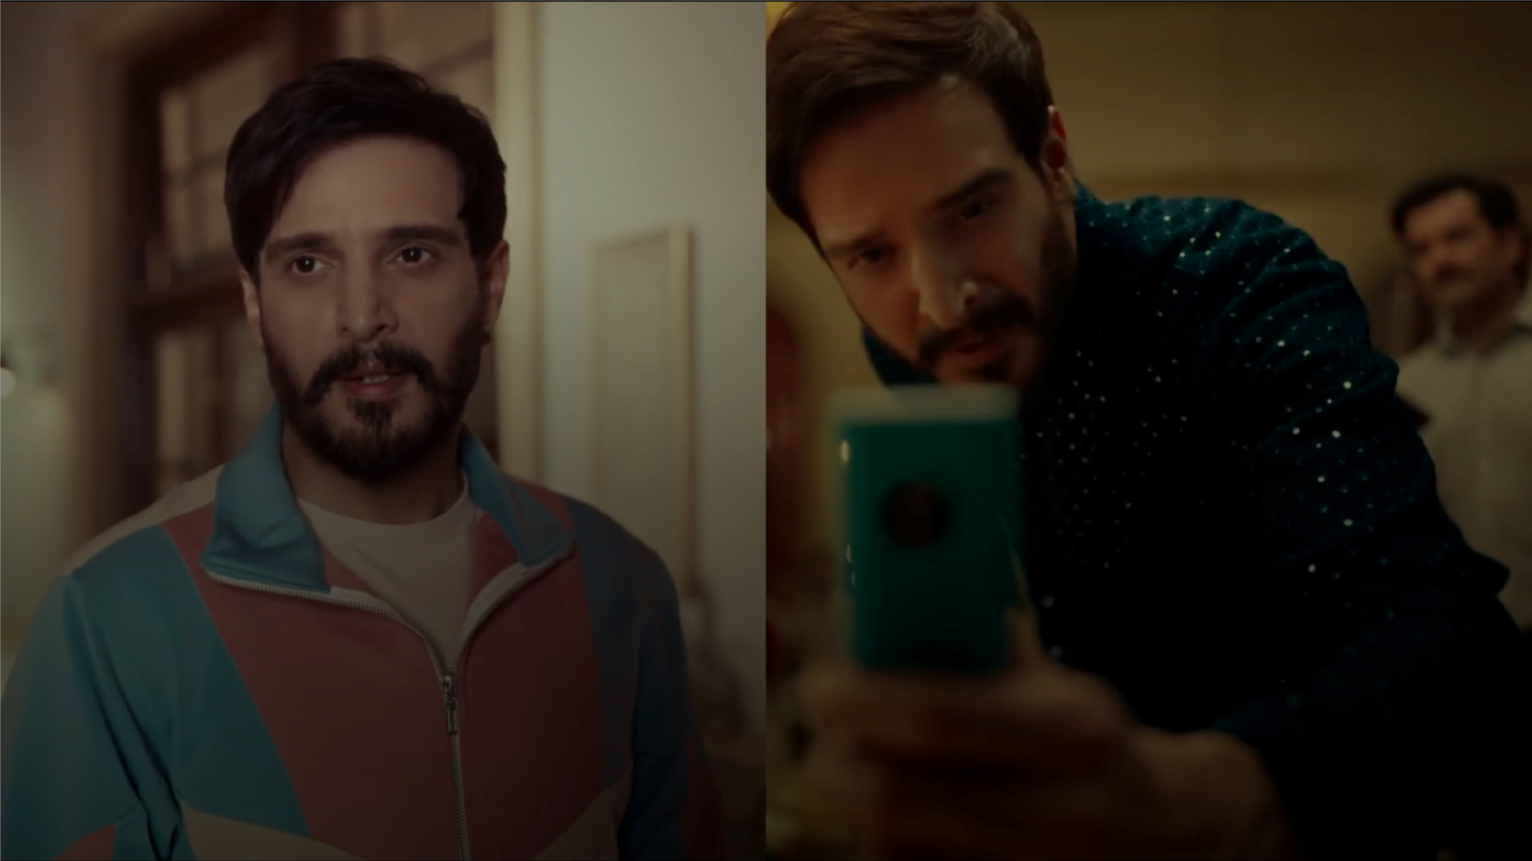
HMD - 105 LAUNCH
Khoob Chalega
▶
Watch on YouTube
▶
Watch on YouTube
Notes:
The Bold Look of Kohler — a cinematic brand film. Note the mood and finish. Click to watch the cut.

Slide 16
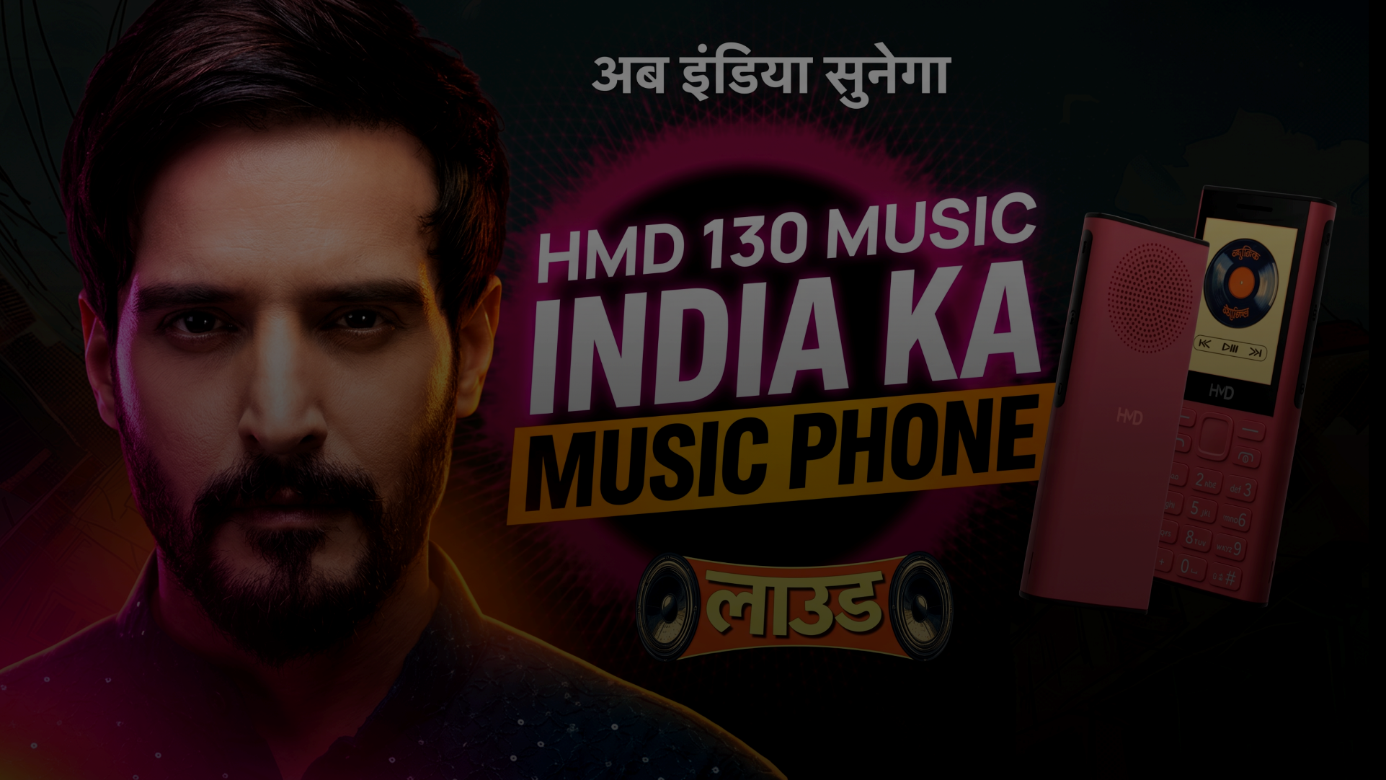
HMD - 130 LAUNCH
Ab India Sunega Loud
▶
Watch on YouTube
Notes:
The Bold Look of Kohler — a cinematic brand film. Note the mood and finish. Click to watch the cut.

Slide 17
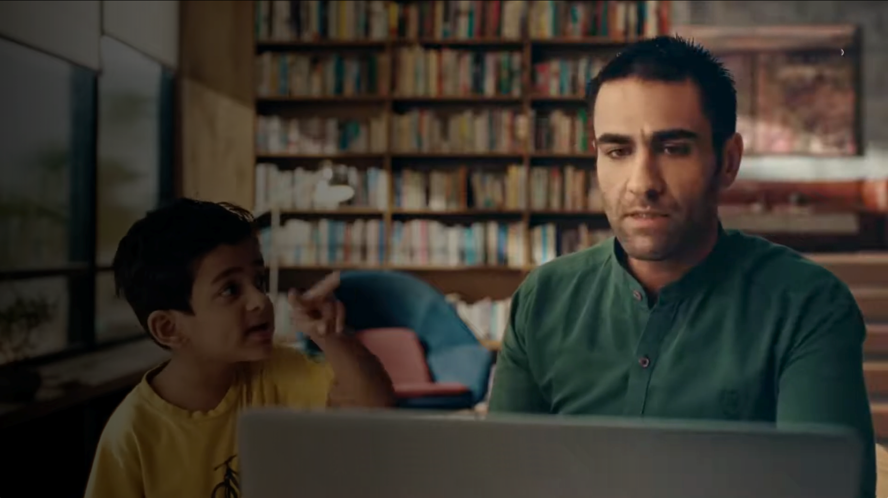
BRAND FILM · KOHLER - STEAM SHOWER
The Bold Look of Kohler
▶
Watch on YouTube
Notes:
The Bold Look of Kohler — a cinematic brand film. Note the mood and finish. Click to watch the cut.

Slide 18
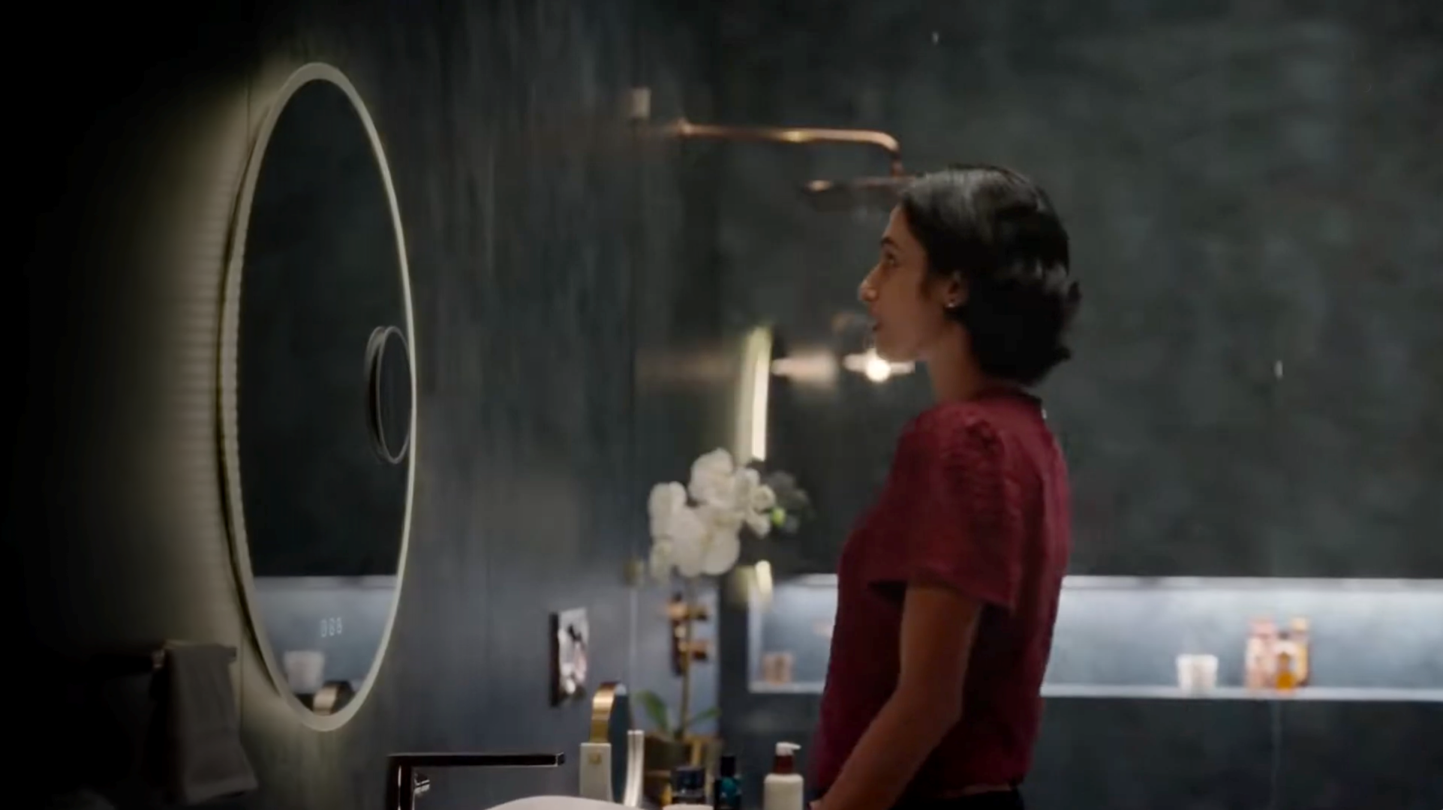
BRAND FILM · KOHLER - MING MIRROR
The Bold Look of Kohler
▶
Watch on YouTube
Notes:
The Bold Look of Kohler — a cinematic brand film. Note the mood and finish. Click to watch the cut.

Slide 19
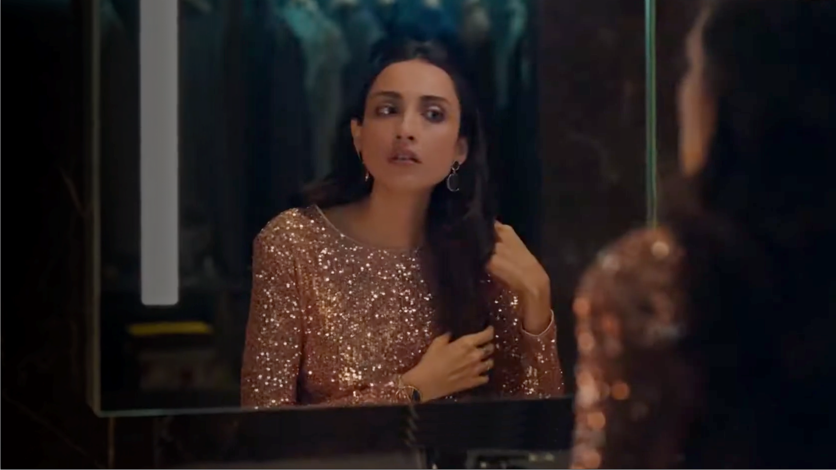
BRAND FILM · KOHLER - VEIL INTELLIGENT TOILET
The Bold Look of Kohler
▶
Watch on YouTube
Notes:
The Bold Look of Kohler — a cinematic brand film. Note the mood and finish. Click to watch the cut.

Slide 20
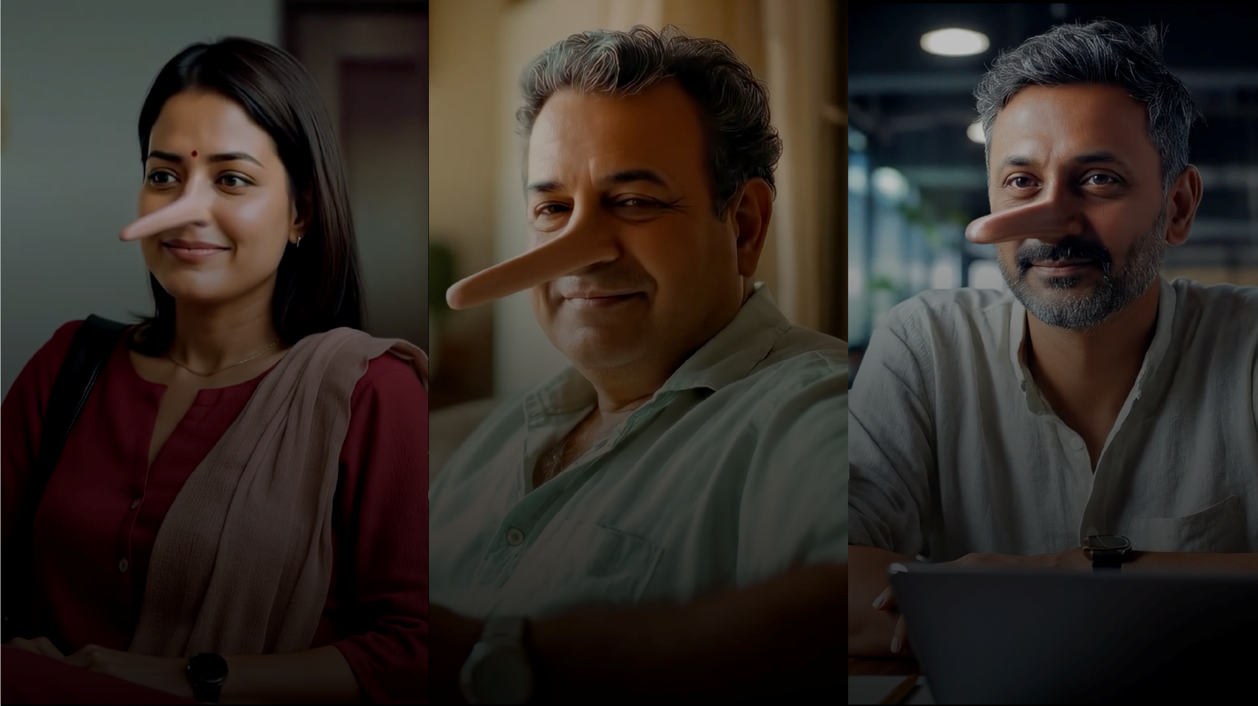
BRAND FILM · Narayana Health Toll Free (AI Video)
78 years of craft at the table
▶
Watch on YouTube
▶
Watch on YouTube
▶
Watch on YouTube
Notes:
The Bold Look of Kohler — a cinematic brand film. Note the mood and finish. Click to watch the cut.

Slide 21
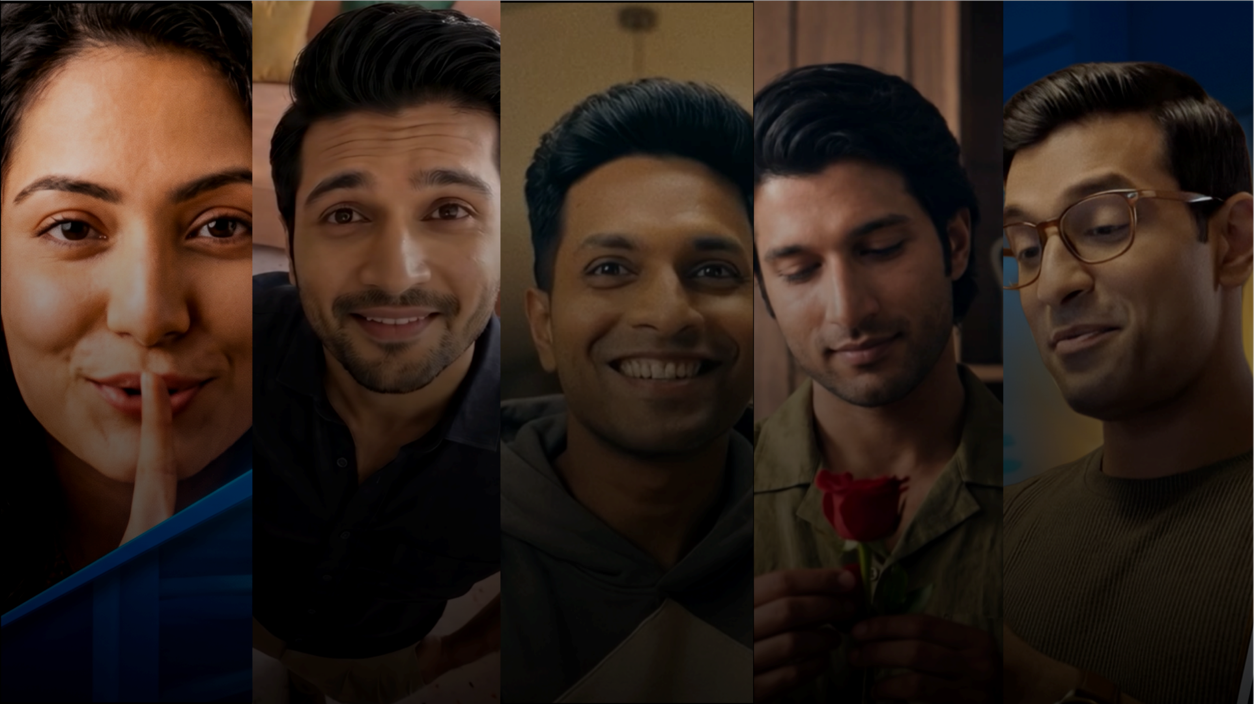
Havells - Lloyd (AI Videos)
It comes to us naturally
▶
Watch on YouTube
▶
Watch on YouTube
▶
Watch on YouTube
▶
Watch on YouTube
▶
Watch on YouTube
Notes:
The Bold Look of Kohler — a cinematic brand film. Note the mood and finish. Click to watch the cut.

Slide 22
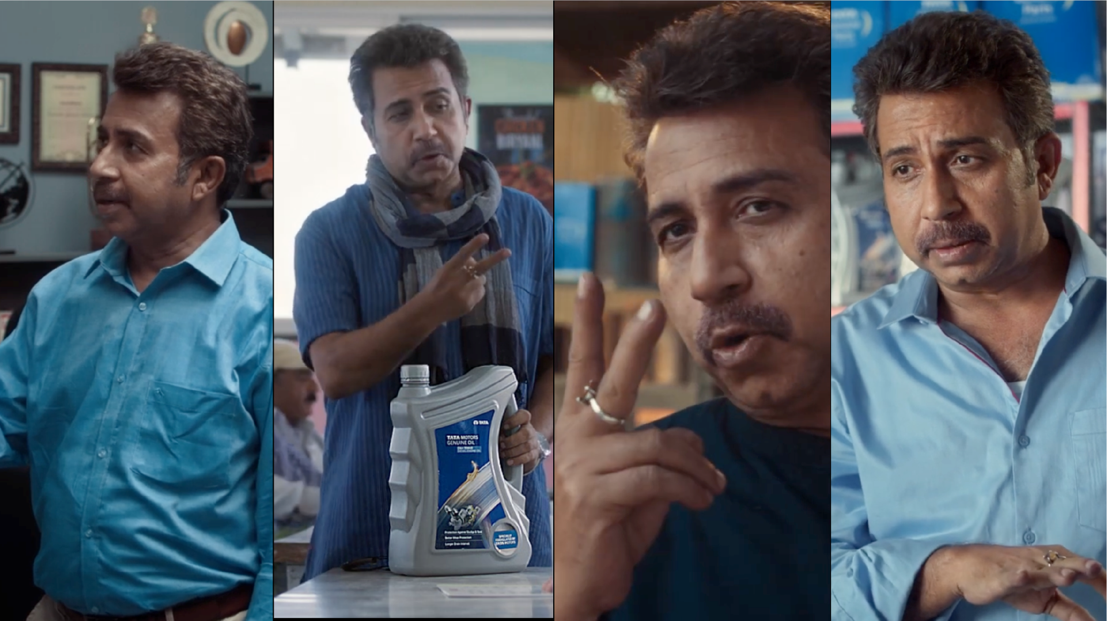
TATA motors · Genuine parts
Do Baatein Ho Sakti Hain
▶
Watch on YouTube
▶
Watch on YouTube
▶
Watch on YouTube
▶
Watch on YouTube
Notes:
The Bold Look of Kohler — a cinematic brand film. Note the mood and finish. Click to watch the cut.

Slide 23
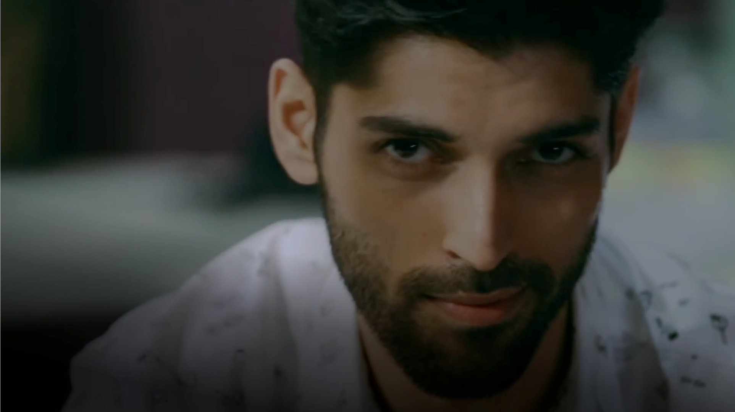
Future brands - John Miller
Good Looking Rascal
▶
Watch on YouTube
Notes:
The Bold Look of Kohler — a cinematic brand film. Note the mood and finish. Click to watch the cut.

Slide 24
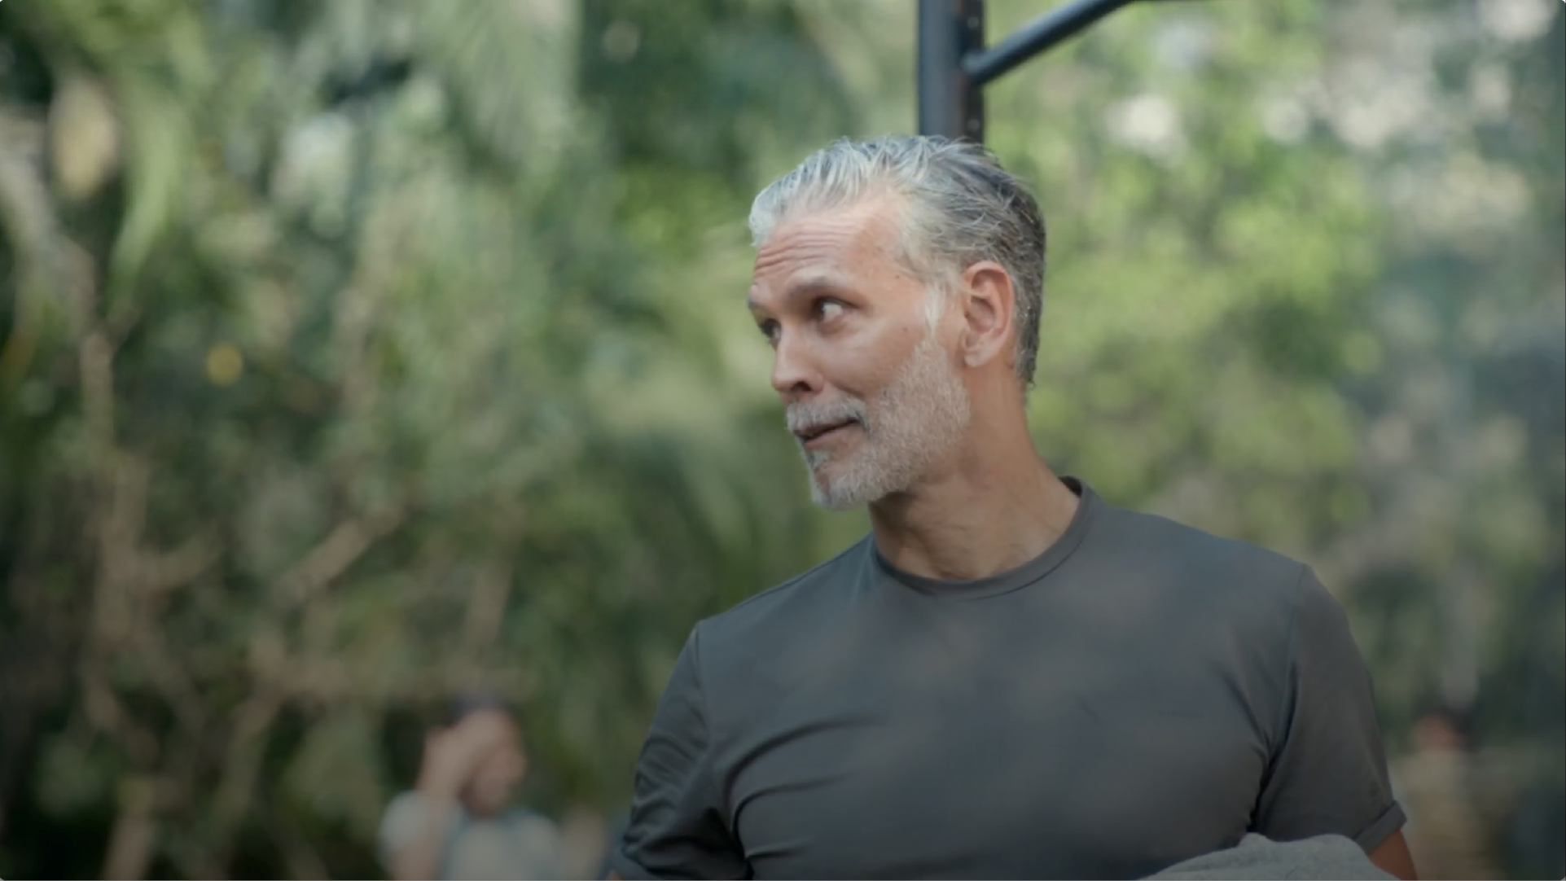
CFS - Staying Sharp at 60
Every eye deserves the best
▶
Watch on YouTube
Notes:
The Bold Look of Kohler — a cinematic brand film. Note the mood and finish. Click to watch the cut.

Slide 25
THE WORK · 02 / 04
02
Social
Always-on content that keeps brands in culture — every single day.
Notes:
Section two — social. The always-on layer that keeps brands in the feed and in the conversation.

Slide 26

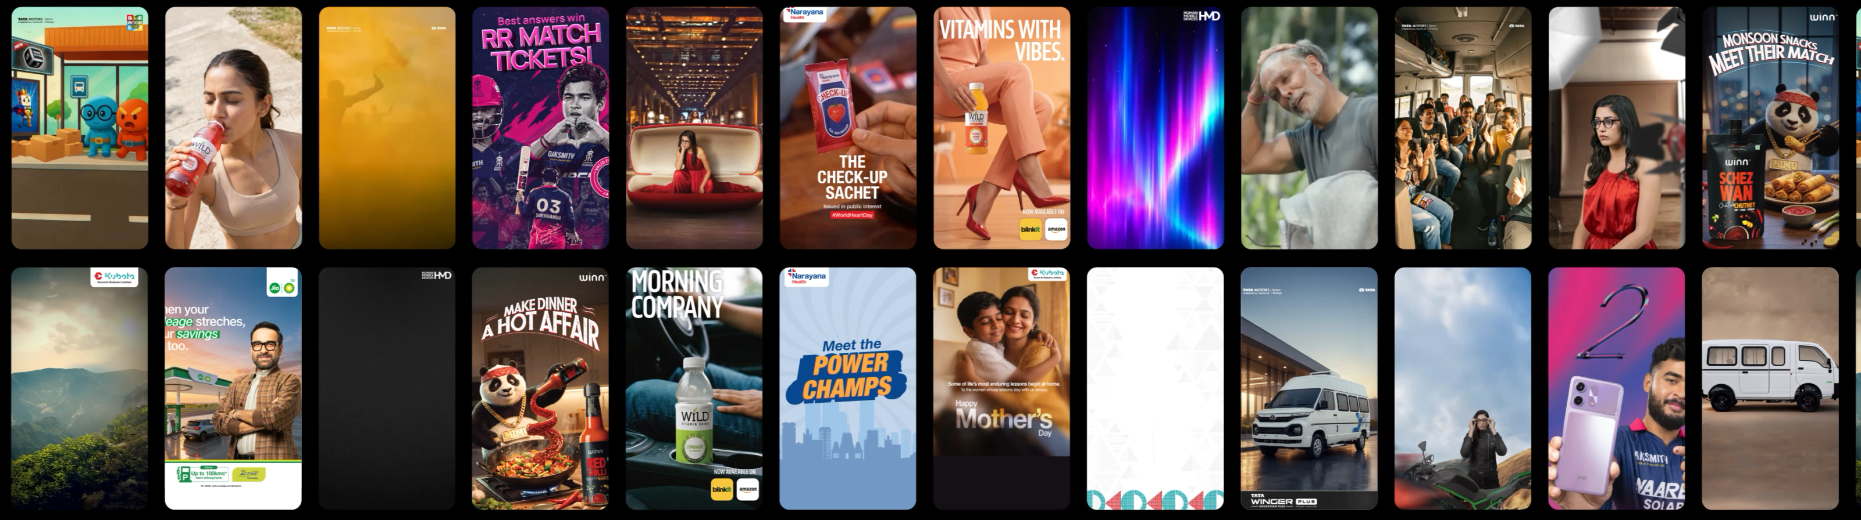
SOCIAL · ALWAYS ON
In the feed, on brand, on trend
Notes:
Always-on for Nokia, Dunkin, Veeba and more — quick, culturally-tuned, on-brand. Volume with taste.

Slide 27
THE WORK · 02 / 04
03
Case Study
Always on content that keeps brands in culture every single day.
Notes:
Section two — social. The always-on layer that keeps brands in the feed and in the conversation.

Slide 28
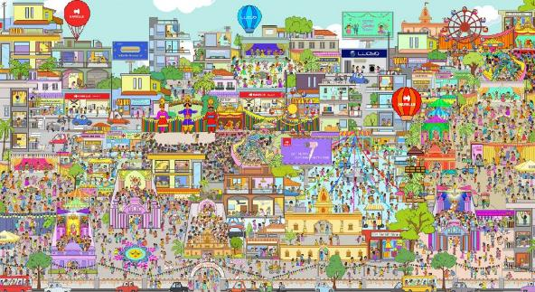
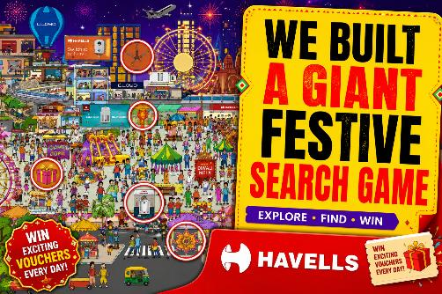
HAVELLS · FESTIVE SEASON CAMPAIGN
The Great Festive Hunt and Gamification
Festive
2.3M
19.2M
2.33M
52
Microsite Visits
People Reached
Social Engagements
Winners Rewarded
& Objective
Drive festive-season engagement and consideration for Havells appliances by recreating the excitement of an Indian festival mela in a digital-first, interactive format.
& Idea
An interactive microsite replicating a lively festival mela, where users hunted for Havells products and festive elements hidden within detailed illustrations - promoted via social media and influencer collaborations, with ₹500 vouchers for winners.
▶
Watch on YouTube
& Result
One of Havells' most interactive festive initiatives - 2.3M microsite visits, 19.2M people reached, 2.33M engagements, and 52 winners rewarded.
🪔
Gamified Storytelling, Festive Scale
A hidden-object hunt turned festive browsing into sustained, rewarded engagement — at mela scale, entirely online.
Notes:
A new D2C brand launched March 2024, priced 35–40% above competitors. We held ROAS between 1.4 and 1.8 — touching 2 — and reached 35 million consumers using influencers, UGC, promos and branded content.

Slide 29
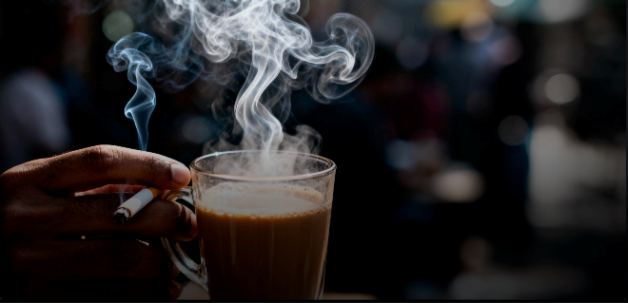
NARAYANA HEALTH · WORLD NO TOBACCO DAY 2025
Chai aur Sutta. Break the Partnership.
Public Health Campaign
& Problem
Chai + cigarette ("Chai Sutta") is a popular combination across India - so ubiquitous that most chai shops sell cigarette packs too, making cigarettes even more accessible.
& Insight
On World No Tobacco Day 2025, we saw an opportunity to use this powerful partnership itself to send a message against excessive smoking in urban cities.
▶
Watch on YouTube
& Idea
Unique chai cups carrying a simple message in regional Indian languages _ reminding people that Chai + Cancer isn't exactly a great use of a break time.
773.5K+
587.1K+
2.9K+
7+
1L+
Impressions
Reach
Total Engagement
Cities Targeted
Cups Distributed
☕
A Habit Confronted at the Source
Turning the very ritual that enables the habit into the medium for the message — reaching smokers exactly where the "sutta" happens.
Notes:
A new D2C brand launched March 2024, priced 35–40% above competitors. We held ROAS between 1.4 and 1.8 — touching 2 — and reached 35 million consumers using influencers, UGC, promos and branded content.

Slide 30
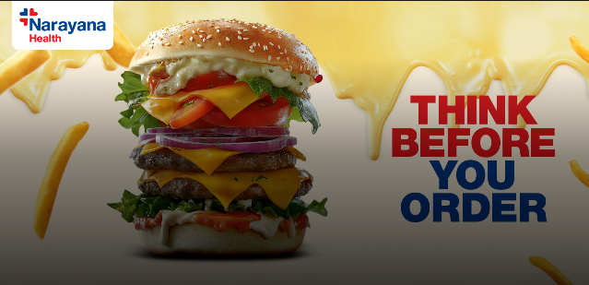
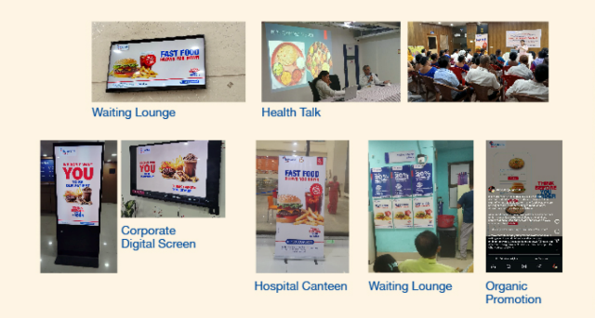
NARAYANA HEALTH · PREVENTIVE HEALTH AWARENESS CAMPAIGN
Think Before You Order
Public Health Campaign
& Problem
In a world of convenience, online food ordering has become second nature, often driven by habit, boredom, or impulse rather than real hunger. For a healthcare brand like Narayana Health, this behaviour isn't just a lifestyle concern, it's a growing public health challenge.
& Objective
▶
Watch on YouTube
Spark a conversation and drive awareness around the long-term health impact of frequent, unhealthy food ordering, especially among the urban youth, inspiring change in their lives, and doing it on their turf: social media.
& Execution
A disruptive social media campaign that hijacked the aesthetics, tone, and addictive appeal of food delivery culture, but flipped it with hard-hitting health truths.
We didn't ask people to stop ordering.
We just asked them to pause, and think before they do.
28M+
17M+
285K+
26.9%
Total Impressions
Reach Across Platforms
Engagements Across Platforms
Rise in Preventive Health Bookings
🍔
A Pause Worth Ordering
"Think Before You Order" made people see themselves culminating into more than a CTA, now a digital-age wellness mantra.
Notes:
A new D2C brand launched March 2024, priced 35–40% above competitors. We held ROAS between 1.4 and 1.8 — touching 2 — and reached 35 million consumers using influencers, UGC, promos and branded content.

Slide 31
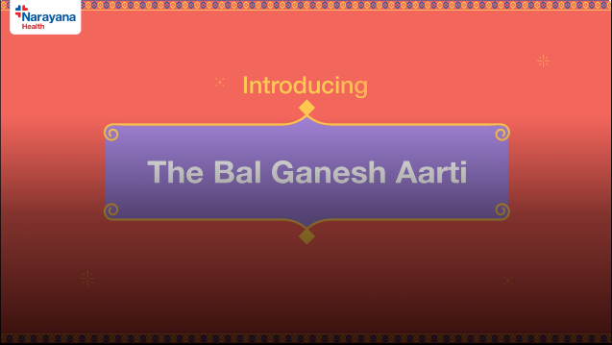
NARAYANA HEALTH · THE BAL GANESHA AARTI
Our devotion to good health
Cultural & Devotional Campaign
& Idea
To become a part of Mumbai's heartbeat and connect with people, not just through care, but through culture, blending wellbeing into the city's spiritual
& Objective
To spark a cultural movement that blended faith and good health. A celebration that made health the new mantra of devotion for families this Ganesh Chaturthi, through the innocent voices of Bappa's little devotees.
& Execution
The Bal Ganesh Aarti, a heartfelt rendition of the Ganesh Aarti, where children prayed to Bappa for good health.
The campaign was launched across social media, carrying a simple, soul-stirring message: When faith inspires better health, the celebration becomes that much more special.
What started as a song soon became a movement. From temples to timelines, the message of good health spread everywhere.
▶
Watch on YouTube
50L+
15.5L+
2.7L+
🙏
Faith Set to the Rhythm of Health
Impressions
A devotional song turned digital movement carrying the message of good health from temples to timelines this Ganesh Chaturthi.
Lives Touched
Engagements
Notes:
A new D2C brand launched March 2024, priced 35–40% above competitors. We held ROAS between 1.4 and 1.8 — touching 2 — and reached 35 million consumers using influencers, UGC, promos and branded content.

Slide 32
THE WORK · 03 / 04
04
Performance
Marketing
Media and funnels engineered to move the number that matters.
Notes:
Section three — performance. Where creativity meets the P&L. Real numbers on real budgets.

Slide 33

HAVELLS FANS · SEO AWARD SUBMISSION
SEO & Organic Traffic & Excellence
951K+
72.7M+
+46.7%
1,582
#BWMERIT - Best SEO Campaign
Total Clicks (GSC)
Impressions
Organic Traffic Growth YoY
Keywords on Page 1
BW Marketing World, Merit Awards
EXECUTIVE SUMMARY
TRAFFIC & SEARCH PERFORMANCE
548,676
693,290
1.32%
283 / 1,299
& Mission
& Scope
& Outcome
27.5%
70,851
Drive organic visibility and qualified traffic to Havells Fans through sustained SEO - technical optimisation, content depth, and keyword expansion.
Fans product & category pages across all segments - ceiling, wall, etc. targeting high-intent commercial keywords.
46.7% YoY traffic growth (374K → 549K sessions), 951K+ clicks, 72.7M+ impressions, consistent 1.32% CTR.
Sessions (vs 374,029 PY)
Total Sessions, +51.3% YoY
Average CTR
Bounce Rate
(vs 40% industry)
Top-3 / Positions 4–10
Peak-Month Traffic (Mar '26)
Clicks/impressions dip Aug–Dec (seasonal, off-season demand), then recover sharply from Jan '26 - confirming resilience is demand-driven, not ranking loss. Mar–Apr '26 hit record highs.
AI & SERP VISIBILITY
SEASONAL STRATEGY — YOY
GOOGLE AI OVERVIEW
GEMINI
CHATGPT
PAA / RICH SNIPPETS
☀️ Peak (Apr–Jul)
+69.7%
Stealth Air named Best Premium & Smart pick (#2)
Positioned as "Premium Aesthetic King" & Best Premium Silent Fan
Named Best Premium Brand & Best Premium Silent Fan in India
Top-2 brand mentions; 4.3★ rating, local SEO & product image on SERP
🌙 Off-Season (Aug–Dec)
+20.1%
🚀 Recovery (Jan–Mar)
+52.5%
A Benchmark in SEO Excellence
Measurable, compounding results across traffic, sessions, visibility, and keyword reach — setting a new digital standard for the fans category.
Content depth & internal linking held off-season rankings; pre-season content refresh drove record March traffic.
Notes:
A new D2C brand launched March 2024, priced 35–40% above competitors. We held ROAS between 1.4 and 1.8 — touching 2 — and reached 35 million consumers using influencers, UGC, promos and branded content.

Slide 34
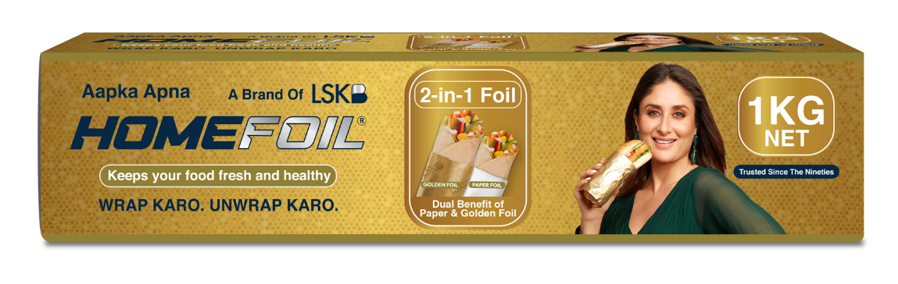
PERFORMANCE · D2C LAUNCH
Homefoil & Premium at Scale
Launched March 2024
OVERVIEW
A new D2C brand launched in March 2024 - priced 35–40% above competitors, and still scaled profitably. Built on influencer-led storytelling, UGC, and festival promotions.
1.4–1.8
35M
+35–40%
Influencers · UGC · Promos Festival Offers · Branded Content
Average ROAS (touched 2.0)
Consumers Reached to Date
Price Premium vs. Competitors
🥇
Premium Pricing, Profitable Scale
Homefoil proves a premium D2C brand can command a 35–40% price premium and still scale to millions — on strong ROAS and creator-led content.
Notes:
A new D2C brand launched March 2024, priced 35–40% above competitors. We held ROAS between 1.4 and 1.8 — touching 2 — and reached 35 million consumers using influencers, UGC, promos and branded content.

Slide 35
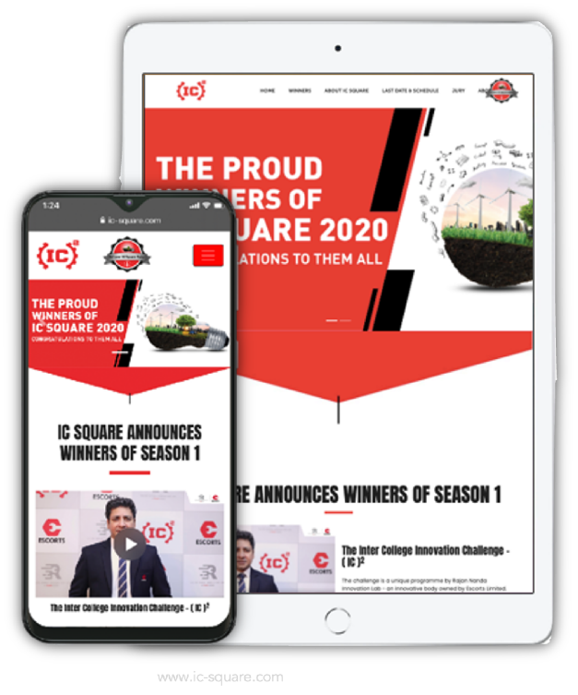
PERFORMANCE · PLATFORM
IC Square
A seed-funding initiative for budding entrepreneurs - pitching agri-machinery, railway-tech and construction ideas online.
300+
450K+
100+
Unique sign-ups
Reach
Ideas pitched
10K+
7K+
₹80K
Video views
Website visits
Total spend
www.ic-square.com
Notes:
A seed-funding platform where budding entrepreneurs pitched agri-machinery, railway-tech and construction ideas online. On a spend of just 80,000 rupees we drove 300+ signups, 450k reach and international entries. Link goes to ic-square.com.

Slide 36
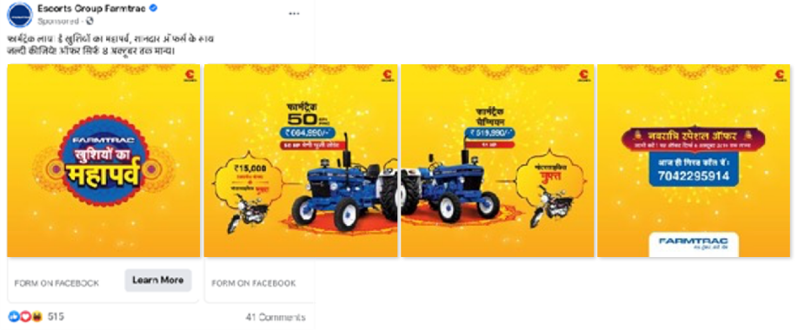
PERFORMANCE · LEAD-GEN · FARMTRAC
77tractors
in just 45 days
A dynamic lead-generation campaign that moved a high-ticket, high-consideration purchase entirely on digital.
Notes:
A dynamic lead-gen campaign for Escorts Farmtrac that sold 77 tractors in 45 days — a big-ticket, high-consideration purchase moved on digital.

Slide 37
THE WORK · 04 / 04
05
Design
Identity and packaging that make a product worth picking up.
Notes:
Section four — design. Identity and packaging: the most tactile proof of craft. Things people pick up and keep.

Slide 38
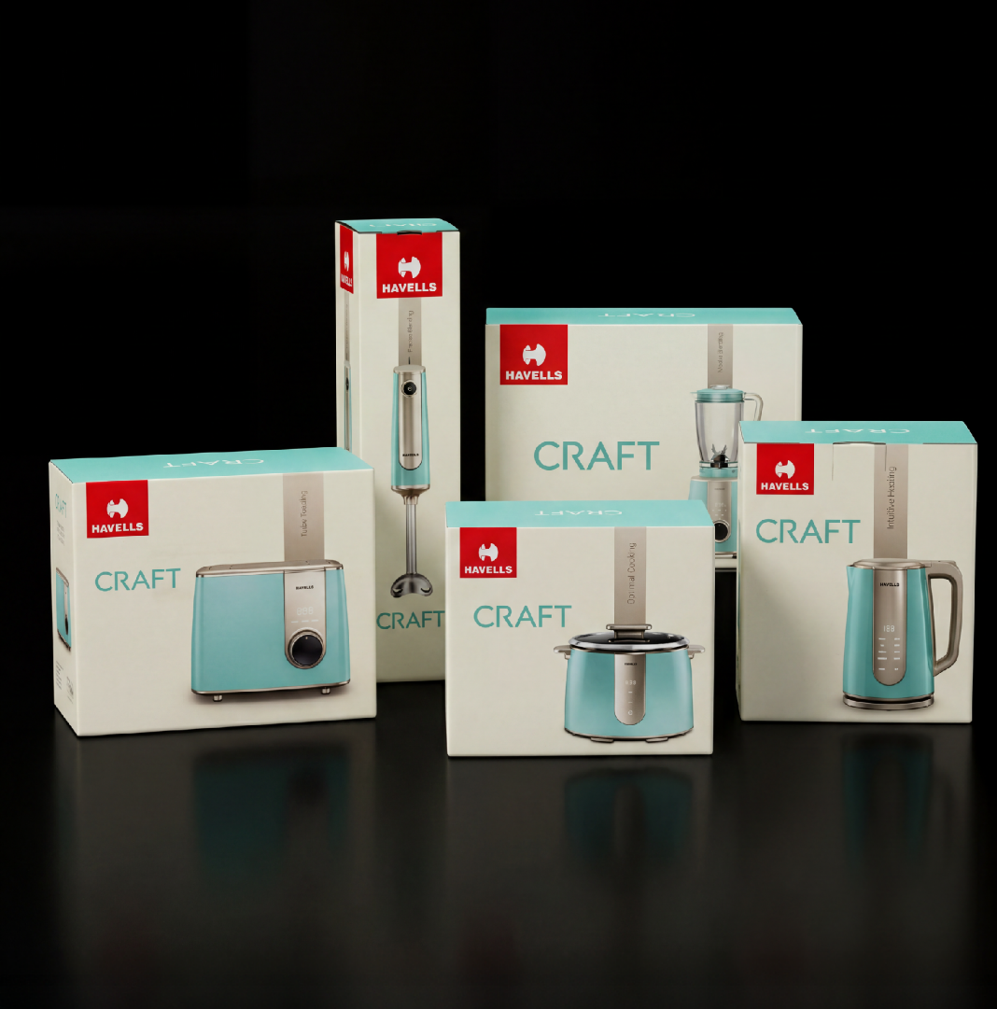
DESIGN · PREMIUM PACKAGING
Craft by Havells
Blending premium design with everyday functionality.
Minimal forms, refined colours, and intuitive technology create timeless kitchen essentials.
Notes:
Premium packaging for Golfer's Shot barrel-aged whisky — a matte-black tube with gold Art-Deco detailing. 'Taste the good life.'

Slide 39
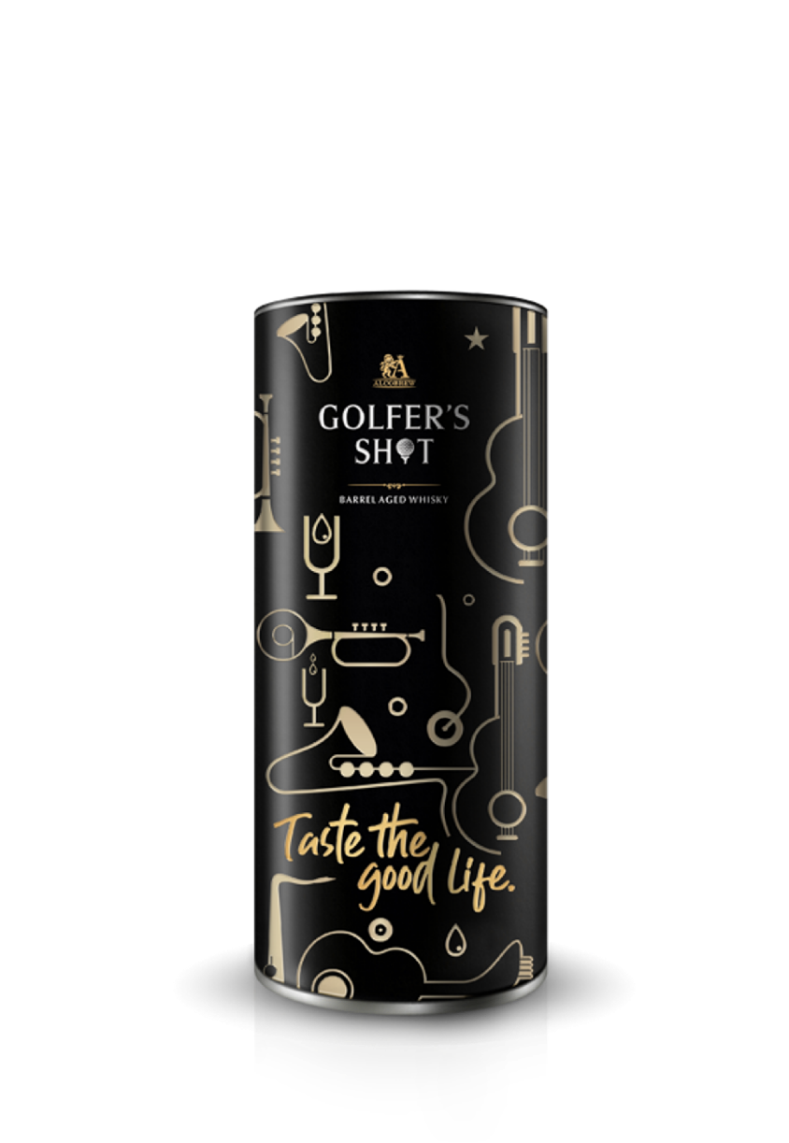
DESIGN · PREMIUM PACKAGING
Golfer's Shot
A barrel-aged whisky in a matte-black tube with gold Art-Deco line work — restrained, tactile, gift-worthy.
Notes:
Premium packaging for Golfer's Shot barrel-aged whisky — a matte-black tube with gold Art-Deco detailing. 'Taste the good life.'

Slide 40
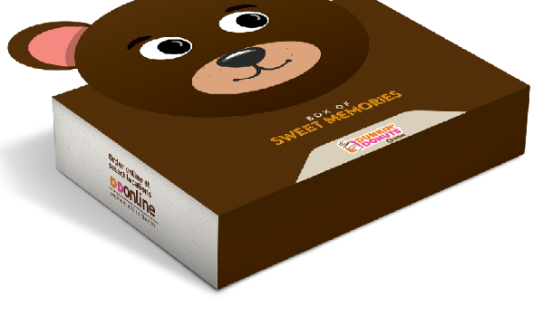
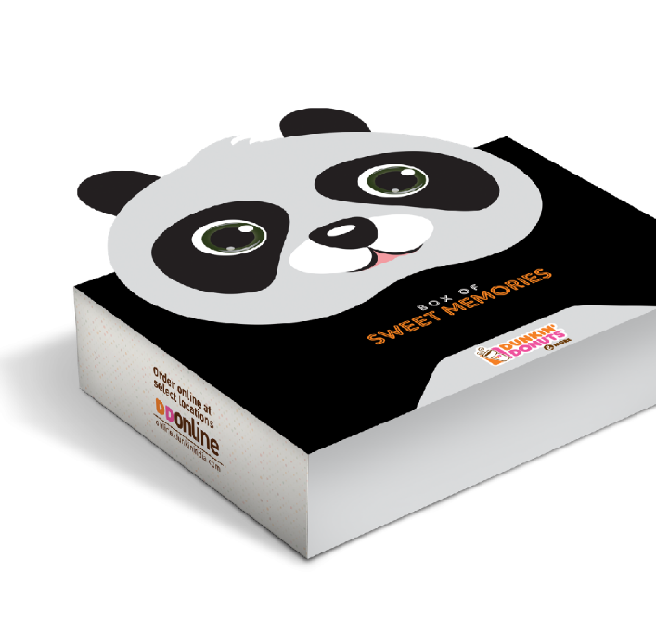
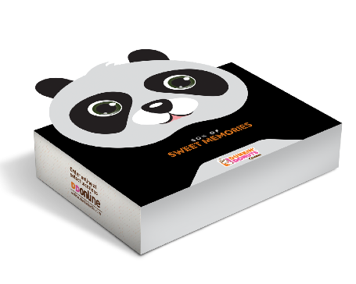
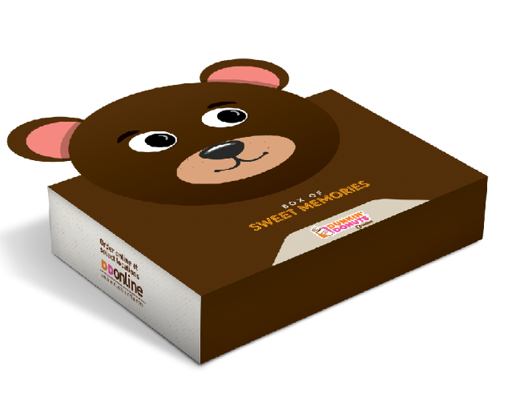

DESIGN · GIFT
Dunkin’ Donuts
From Character boxes to gift sets
Notes:
Structural and gift packaging — character-led confectionery boxes and premium spirit gift packs for Absolut, Bacardi and Chivas. Range across the price ladder.

Slide 41
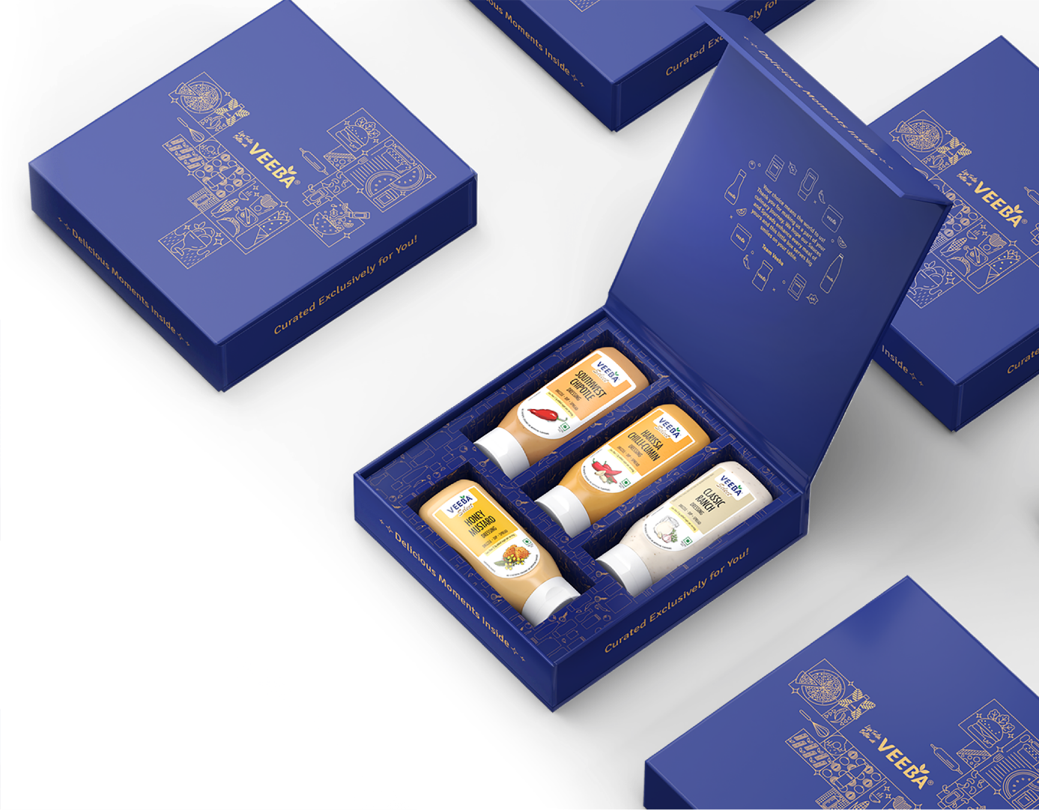
DESIGN · GIFT BOX
Veeba
A Story Before the First Taste
Notes:
Structural and gift packaging — character-led confectionery boxes and premium spirit gift packs for Absolut, Bacardi and Chivas. Range across the price ladder.

Slide 42

DESIGN · RANGE IDENTITY
WhyFryy
one system, five flavours
Popped, not fried. Flavour-coded packs that hold together and pop on shelf.
Notes:
A full range identity for Why Fryy — popped, not fried. One bold system, five flavour-coded packs that pop on shelf and scale.

Slide 43


DESIGN · GIFT
Pernod Ricard
Premium gift box design for festival celebration.
Notes:
A full range identity for Why Fryy — popped, not fried. One bold system, five flavour-coded packs that pop on shelf and scale.

Slide 44





DESIGN · Brand Identity
Wyder
Notes:
A full range identity for Why Fryy — popped, not fried. One bold system, five flavour-coded packs that pop on shelf and scale.

Slide 45





DESIGN · Brand Identity
Cityfurnish
Notes:
A full range identity for Why Fryy — popped, not fried. One bold system, five flavour-coded packs that pop on shelf and scale.

